Slide 1
Software Requirement Engineering
Software Requirement Prioritization
Muhammad Nasir
m.nasir@iiu.edu.pk

Slide 2
Outline
Why Requirement Prioritization?
How do to it?
A Cost-Value Approach
Estimating Cost-Value
Complications
Hierarchical prioritization
Analytic Hierarchy Process (AHP)
AHP example - estimating costs
Plot ROI graph
Other selection criteria
Sources of Conflict
Basic approaches to conflict resolution

Slide 3
Why Prioritize Requirements?
There are usually more requirements than you can implement given stakeholder`s time and resource constraints...
... on the other hand, systems have useless functions for the users and customers!

Slide 4
Why Prioritize Requirements?
Large amount of the software functions are “rarely” (19%) or “never used” (45%)
“How to select a subset of the customers’ requirements and still produce a system that meets their needs?”

Slide 5
Why Prioritize Requirements?
“Prioritization means balancing the business benefit of each requirement against its cost and any implications it has for the architectural foundation and future evolution of the product”

Slide 6
Why Prioritize Requirements?
Need to select what to implement
Customers (usually) ask for way too much
Balance time-to-market with amount of functionality
Decide which features go into the next release

Slide 7
How to do it?
For each requirement/feature, ask:
How important is this to the customer?
How much will it cost to implement?
How risky will it be to attempt to build it?

Slide 8
How to do it?
Some requirements must be included
Some requirements should definitely be excluded
That leaves a pool of “nice-to-haves”, which we must select from

Slide 9
Hierarchical Prioritization
Group Requirements into a hierarchy, e.g. A goal tree, e.g. A NFR tree
Only make comparisons between branches of a single node:

Slide 10
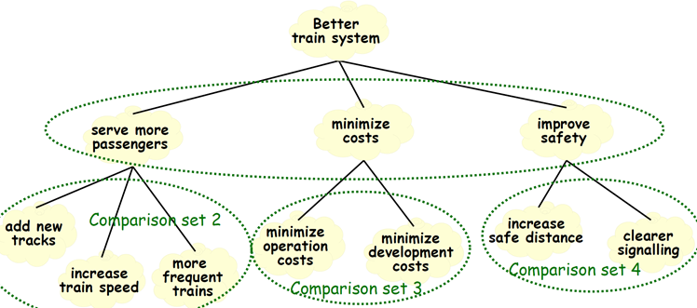
Hierarchical Prioritization

Slide 11
A Cost-Value Approach
Calculate return on investment
Assess each requirement’s importance to the project as a whole
  Assess the relative cost of each requirement
  Assess the relative value of each requirement
  Compute the cost-value trade-off:

Slide 12
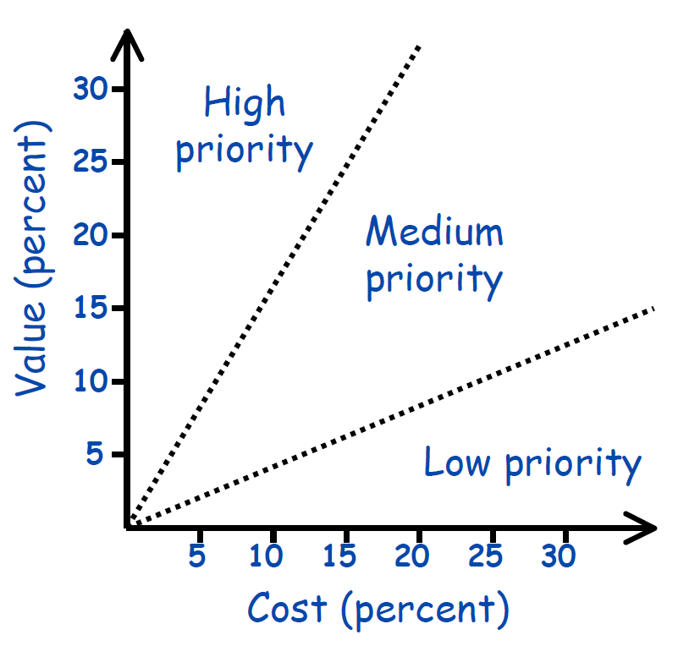
A Cost-Value Approach

Slide 13
Estimating Cost & Value
Two approaches:
Absolute scale (e.g., dollar values)
  Requires much domain experience
Relative values (e.g., less/more; a little, somewhat, very)
  Much easier to elicit
  Prioritization becomes a sorting problem

Slide 14
Estimating Cost & Value
Comparison Process - options
Basic sorting - for every pair of requirements (i,j), ask if i>j?

Slide 15
Complications
Hard to quantify differences, easier to say “x is more important than y”……than to estimate by how much.
Not all requirements comparable, e.g., different level of abstraction, e.g., core functionality vs. customer enhancements
Requirements may not be independent

Slide 16
Complications
No point selecting between X and Y if they are mutually dependent
Stakeholders may not be consistent, e.g. If X > Y, and Y > Z, then presumably X > Z?
Stakeholders might not agree, different cost/value assessments for different types of stakeholder

Slide 17
Analytic Hierarchy Process (AHP)
Create n x n matrix (for n requirements)
For element (x,y) in the matrix enter:
1 - if x and y are of equal value
3 - if x is slightly more preferred than y
5 - if x is strongly more preferred than y
7 - if x is very strongly more preferred than y
9 - if x is extremely more preferred than y
(use the intermediate values, 2,4,6,8 if compromise needed) and for (y , x) enter the reciprocal.

Slide 18
Analytic Hierarchy Process (AHP)
This gives a value for each requirement:
…giving the estimated percentage of total value of the project

Slide 19
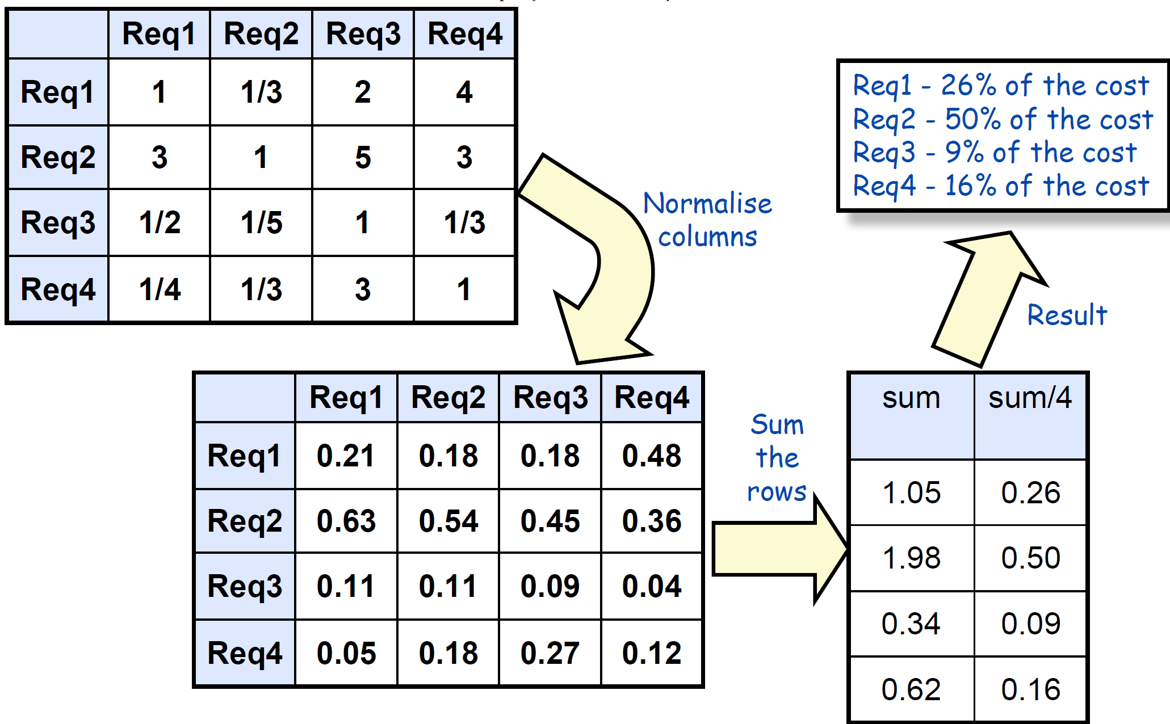
AHP example - estimating costs

Slide 20
Plot ROI graph
Do AHP process twice:
Once to estimate relative value
Once to estimate relative cost
Use results to calculate ROI ratio:

Slide 21
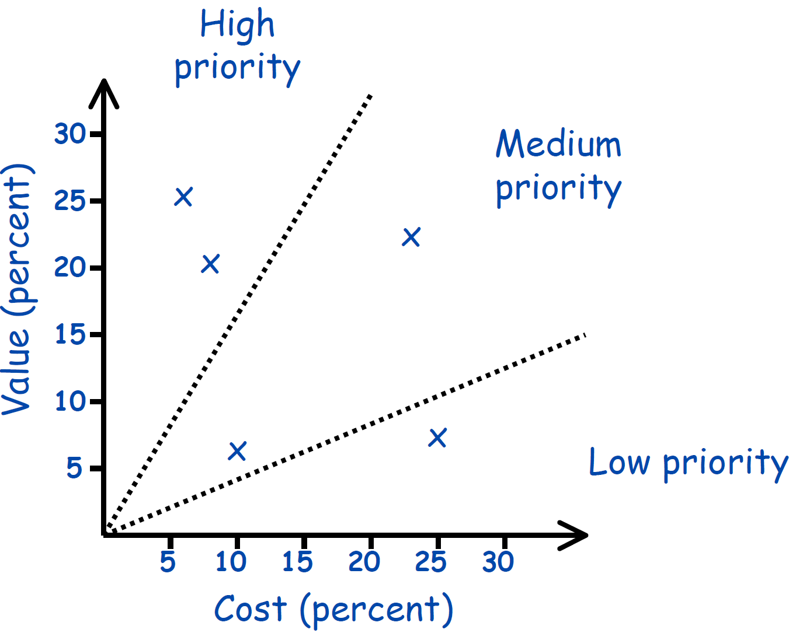
Plot ROI graph

Slide 22
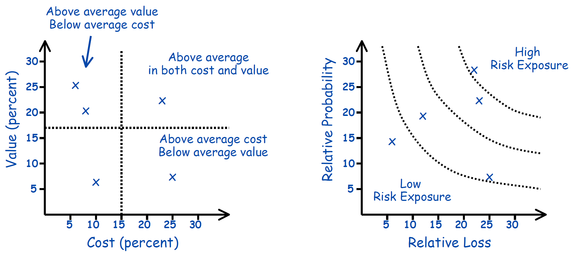
Other selection criteria
ROI ratio is not the only way to group requirements

Slide 23
Sources of Conflicts
Causes of Conflict
Deutsch (1973):
Control over resources
Preferences and annoyances (Activities of one-party influence upon another)
Values (a claim that a value or set of values should dominate)
Beliefs (dispute over facts, information, reality, etc.) the nature of the relationship between the parties.
Notes:
DOIGE

Slide 24
Sources of Conflicts
Robbins (1989):
Communicational (In-sufficient exchange of information, noise, selective perception)
Structural (goal compatibility, leadership style)
Personal factors, (individual value systems, personality characteristics)

Slide 25
Sources of Conflicts
Deviant behavior & conflict are normal in small group decision making
More aggression and less co-operation when communication is restricted
A decrease in communication tends to intensify a conflict (the contact hypothesis)
Heterogeneous teams experience more conflict;
Homogeneous groups are more likely to make high risk decisions (groupthink)

Slide 26
Basic approaches to conflict resolution
Negotiation
…is collaborative exploration:
participants seek a settlement
that satisfies all parties as much as possible, also known as:
integrative behavior
constructive negotiation
distinct from:
disruptive/competitive

Slide 27
Basic approaches to conflict resolution
Competition
is maximizing your own gain:
no regard for the degree of satisfaction of other parties.
but not necessarily hostile!
Extreme form:
when all gains by one party are at the expense of others

Slide 28
Basic approaches to conflict resolution
Third Party Resolution
Participants appeal to outside source
The rule-book, a figure of authority, or the toss of a coin.
Can occur with the breakdown of either negotiation or competition as resolution methods.

Slide 29
The End
Thanks for listening
Questions would be appreciated.

